Slide 1

Design Work
Richa Garg
01
02
03
04
Know your users
Attention to patterns
Consistency
Keep it simple
Know your user

Slide 2
Know your users
01
User’s goals are our goals, so we learn about user’s experience, and what they need.
Attention to patterns
02
Users spend the majority of their time on interfaces. By using familiar UI patterns, we will help users feel convenient.
Consistency
03
Users need consistency. They need to know that once they learn to do something, they will be able to repeat. We create consistent designs which increases efficiency.
Keep it simple
04
The best interface designs are invisible. They do not contain UI-bling or unnecessary elements. Instead, the necessary elements are succinct and make sense. So we create simple designs.

Slide 3


Projects
East West Bank
Kinecta
BFSFCU
Public Bank
Meem
Kony IQ
App Platform V 9.0
Admin Server Console
Know your user

Slide 4
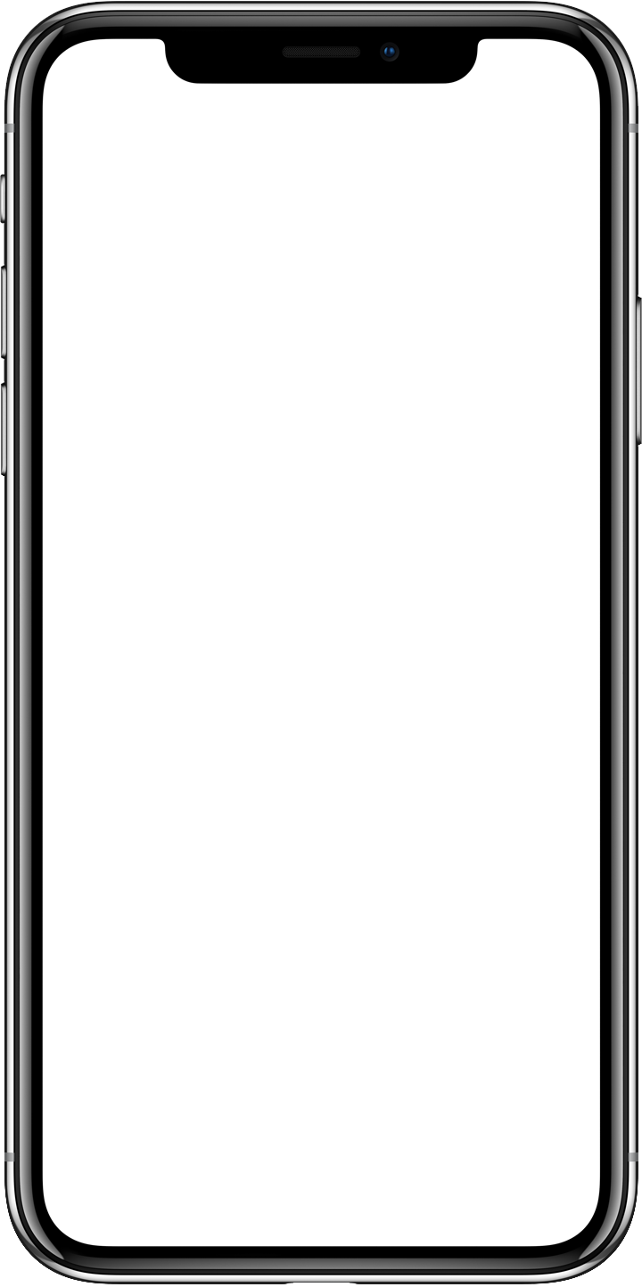

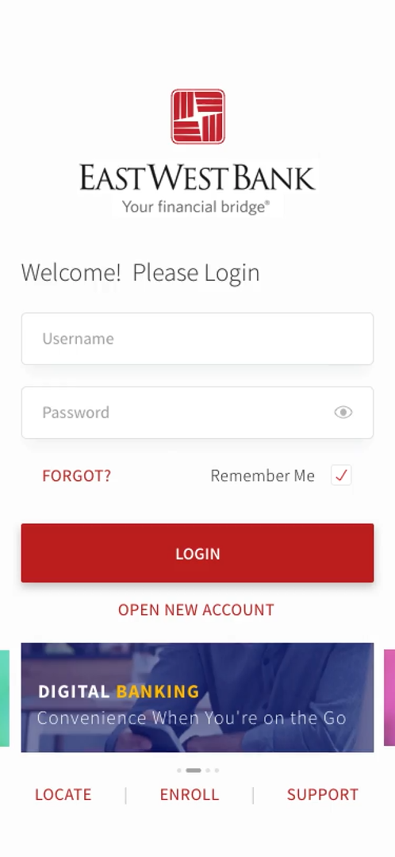
East West Bank
Category: Banking
Research
'Red Envelope’ – A custom in China of gifting money using red envelopes during Chinese lunar new year.
Summary
An extensive research enable us to create an end-to-end traditional Chinese experience of sending and receiving money using Red Envelope, which was very well received by EWB team.
Know your user

Slide 5
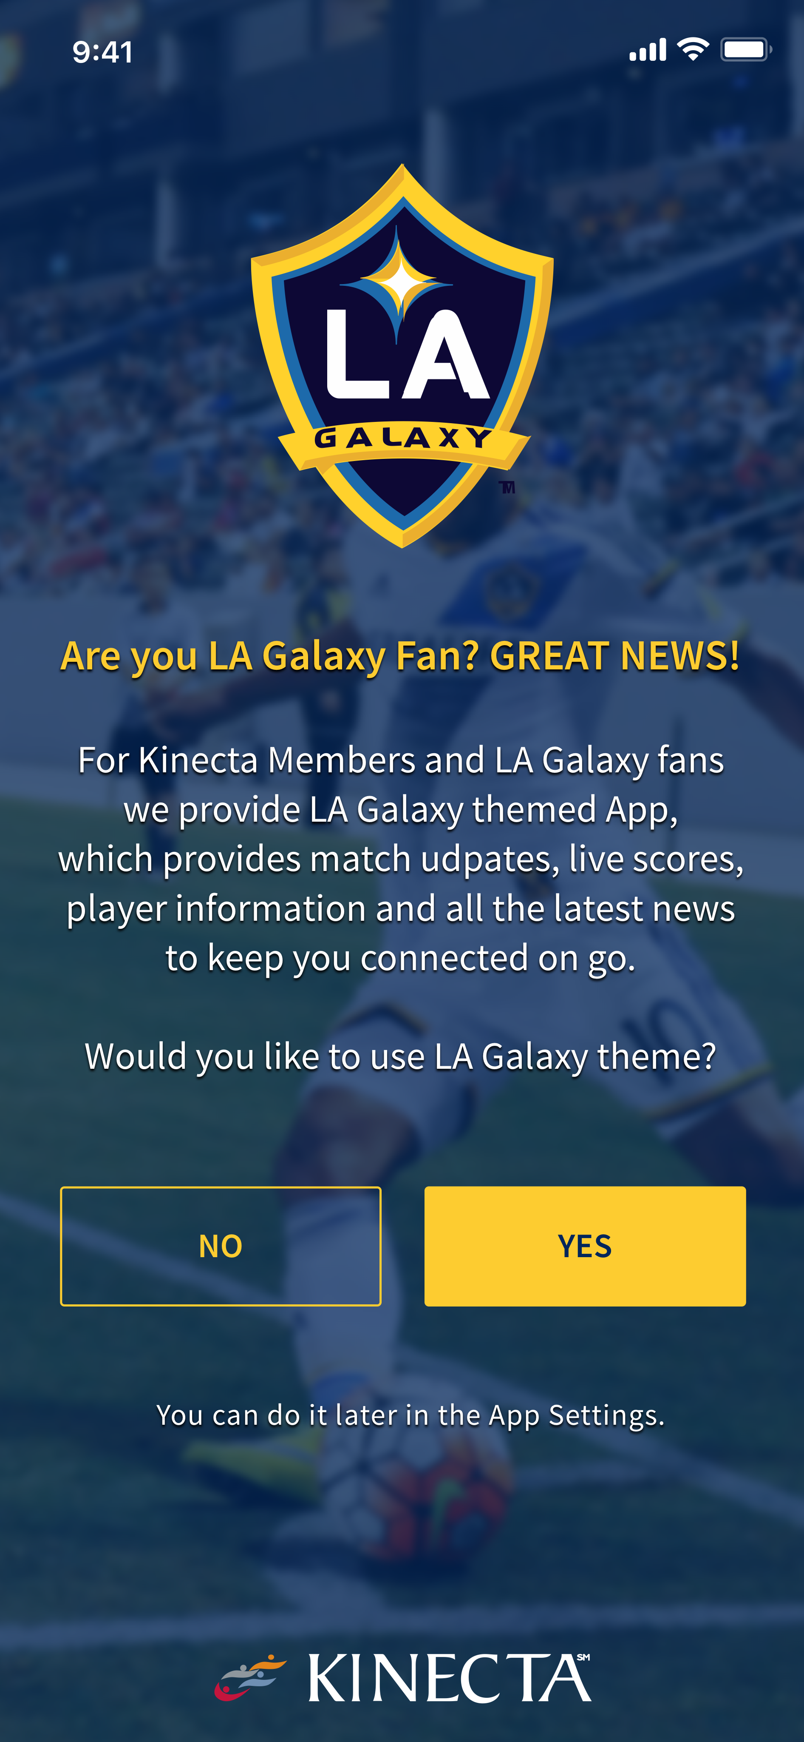
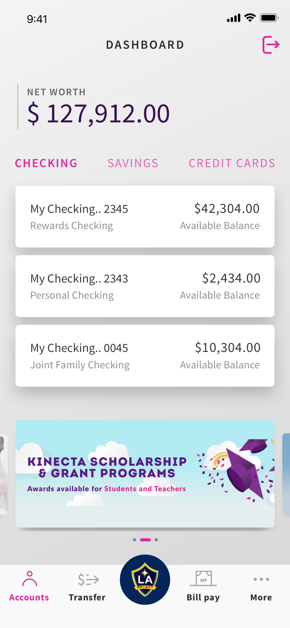
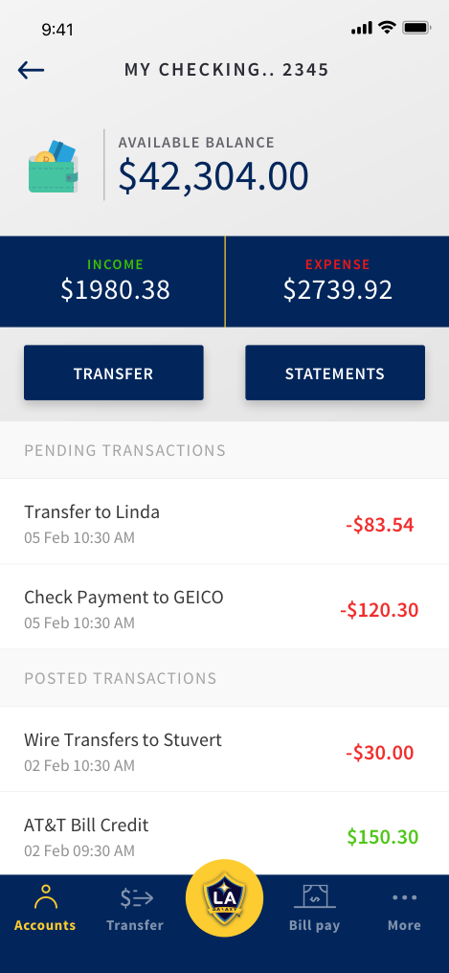
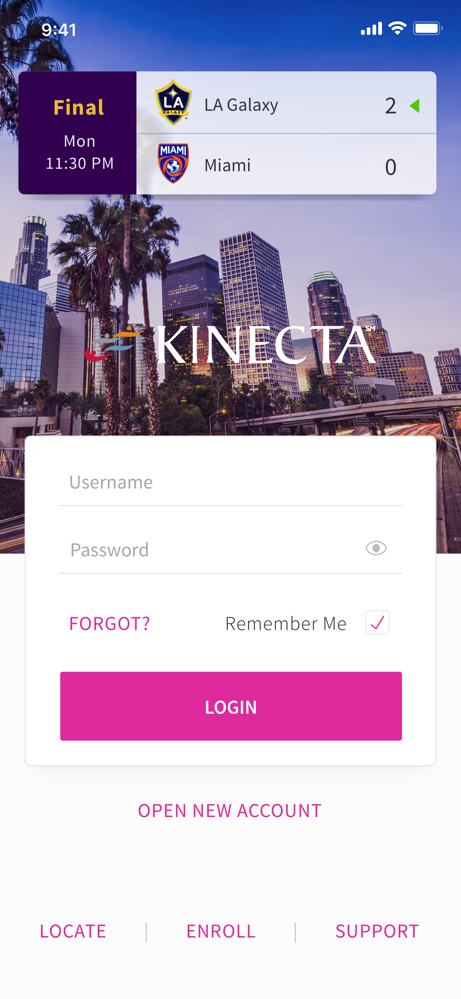
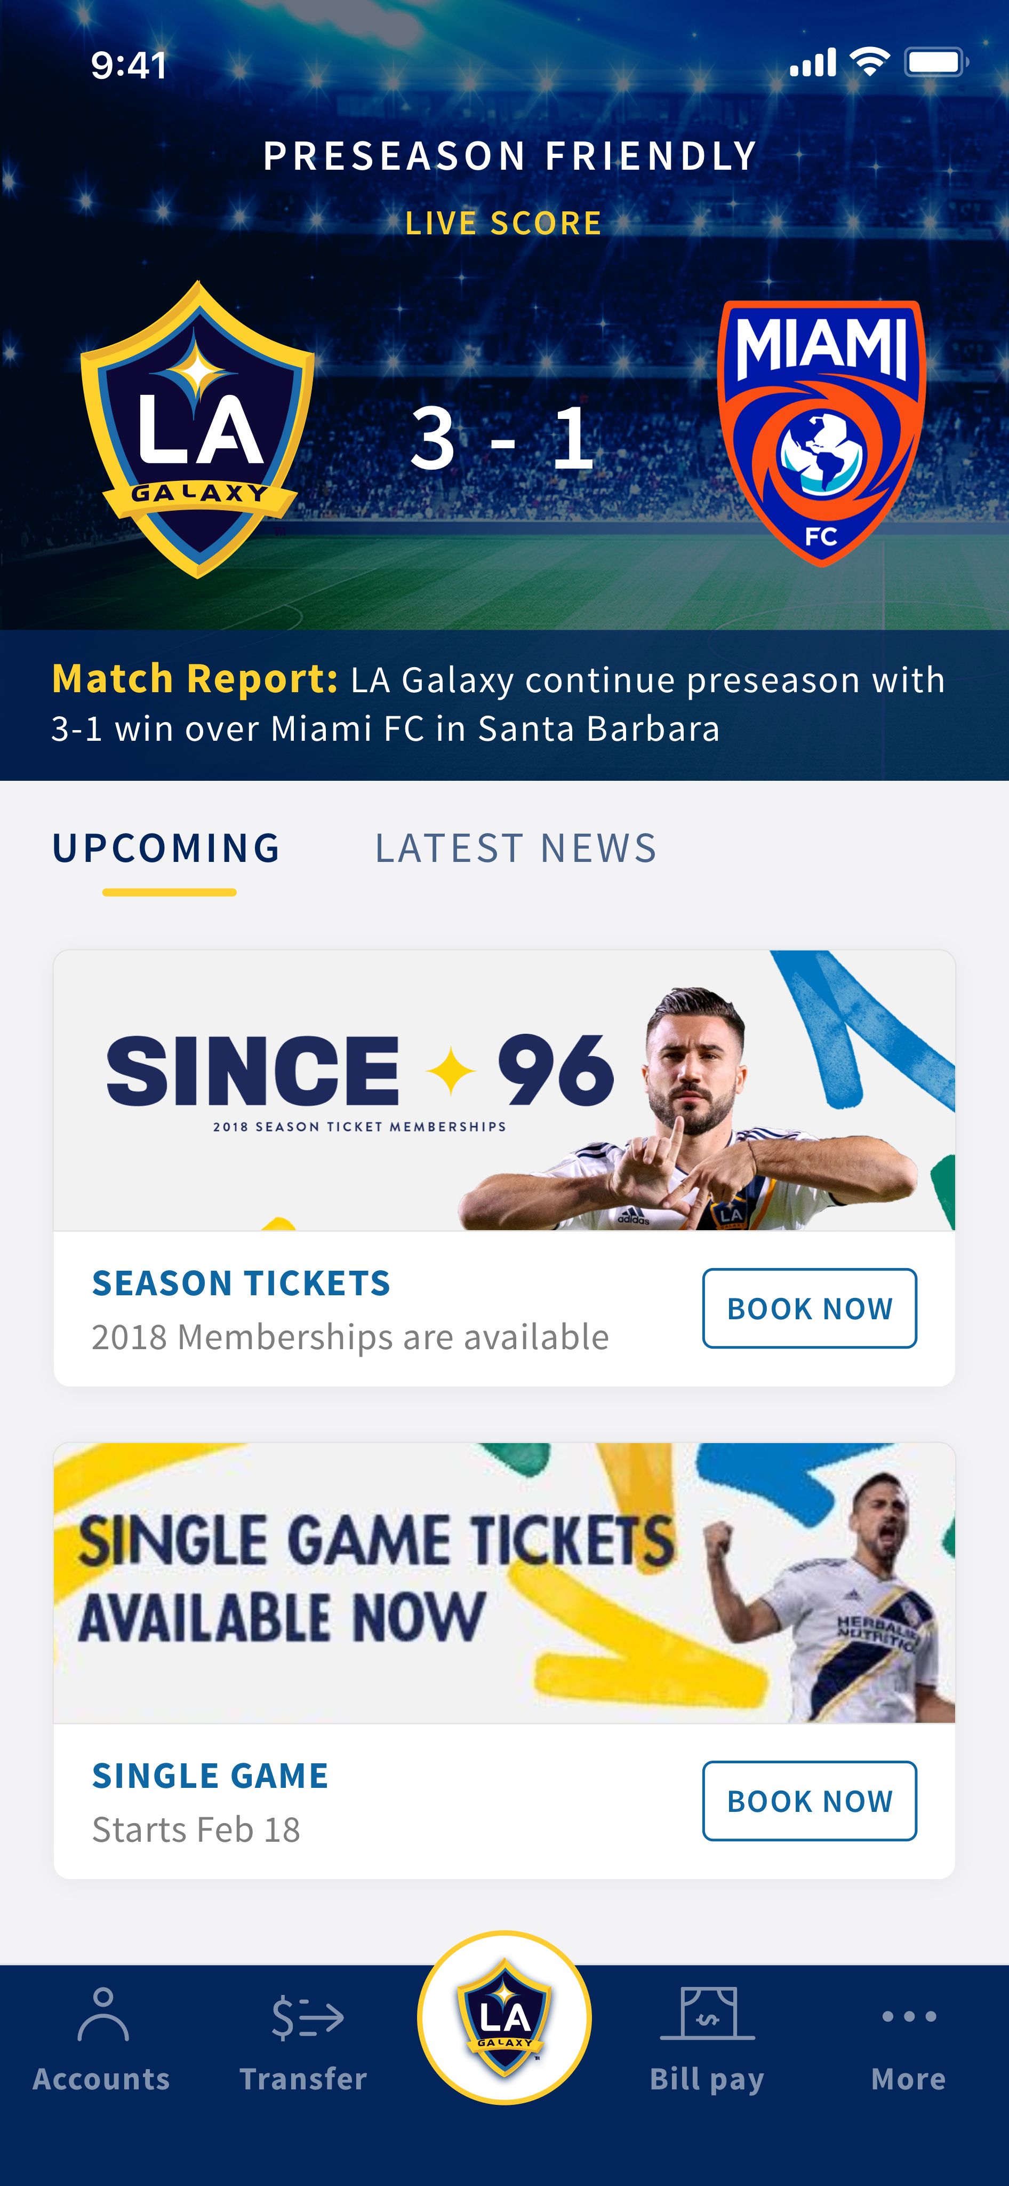
Kinecta
Category: Banking
Research
‘Brand’ – Thorough understanding of respective brand and sponsorship relationship.
Summary :
A thorough understanding of each brand and the relationship enable us to create an gelling experience between banking only vs LA Galaxy banking users.
Know your user

Slide 6
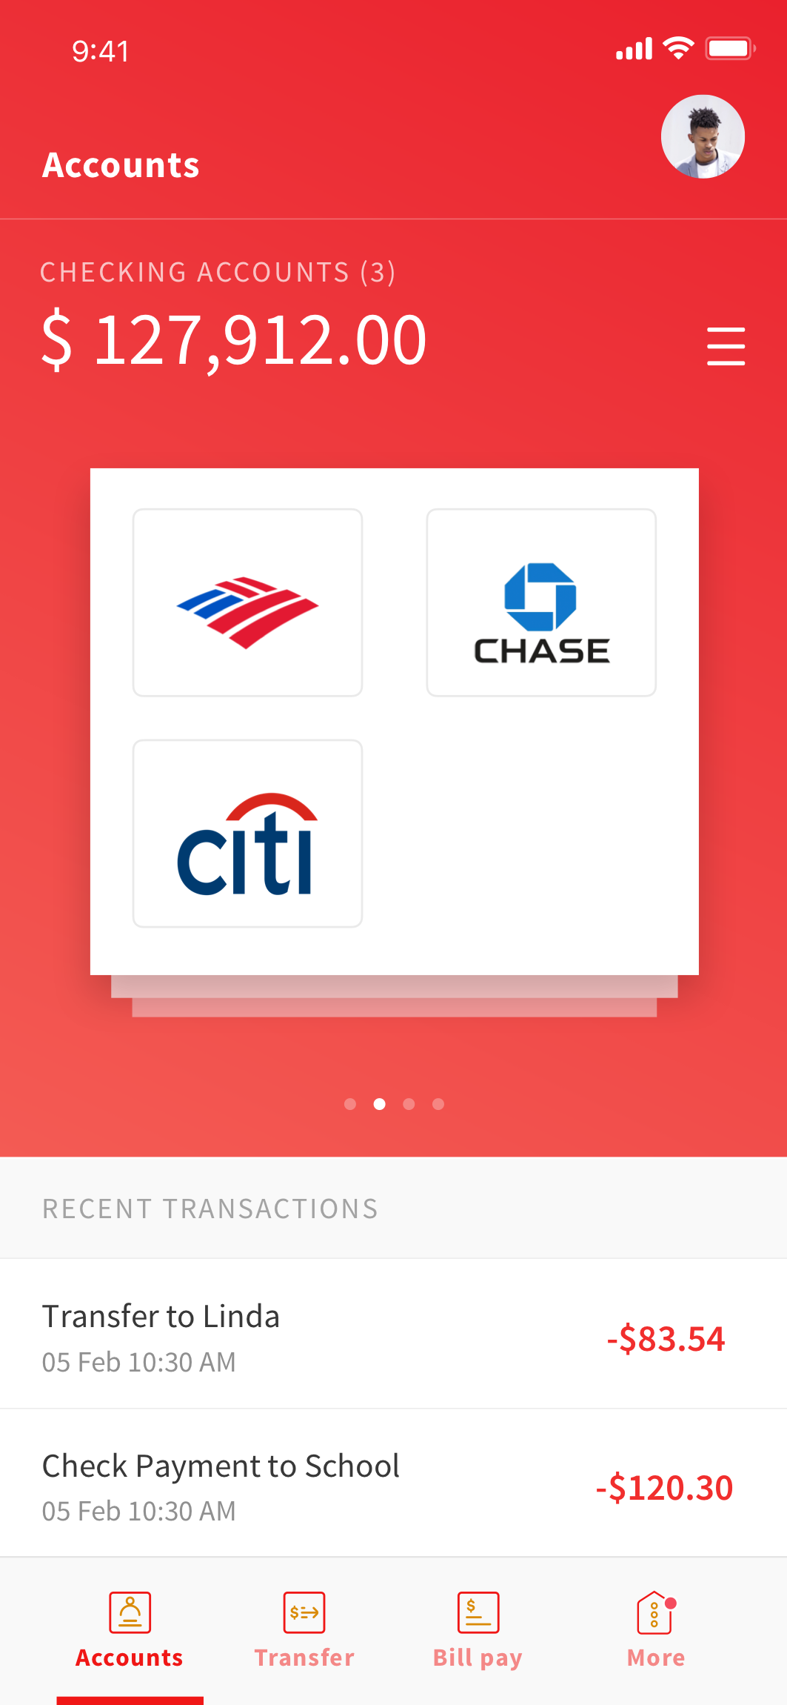
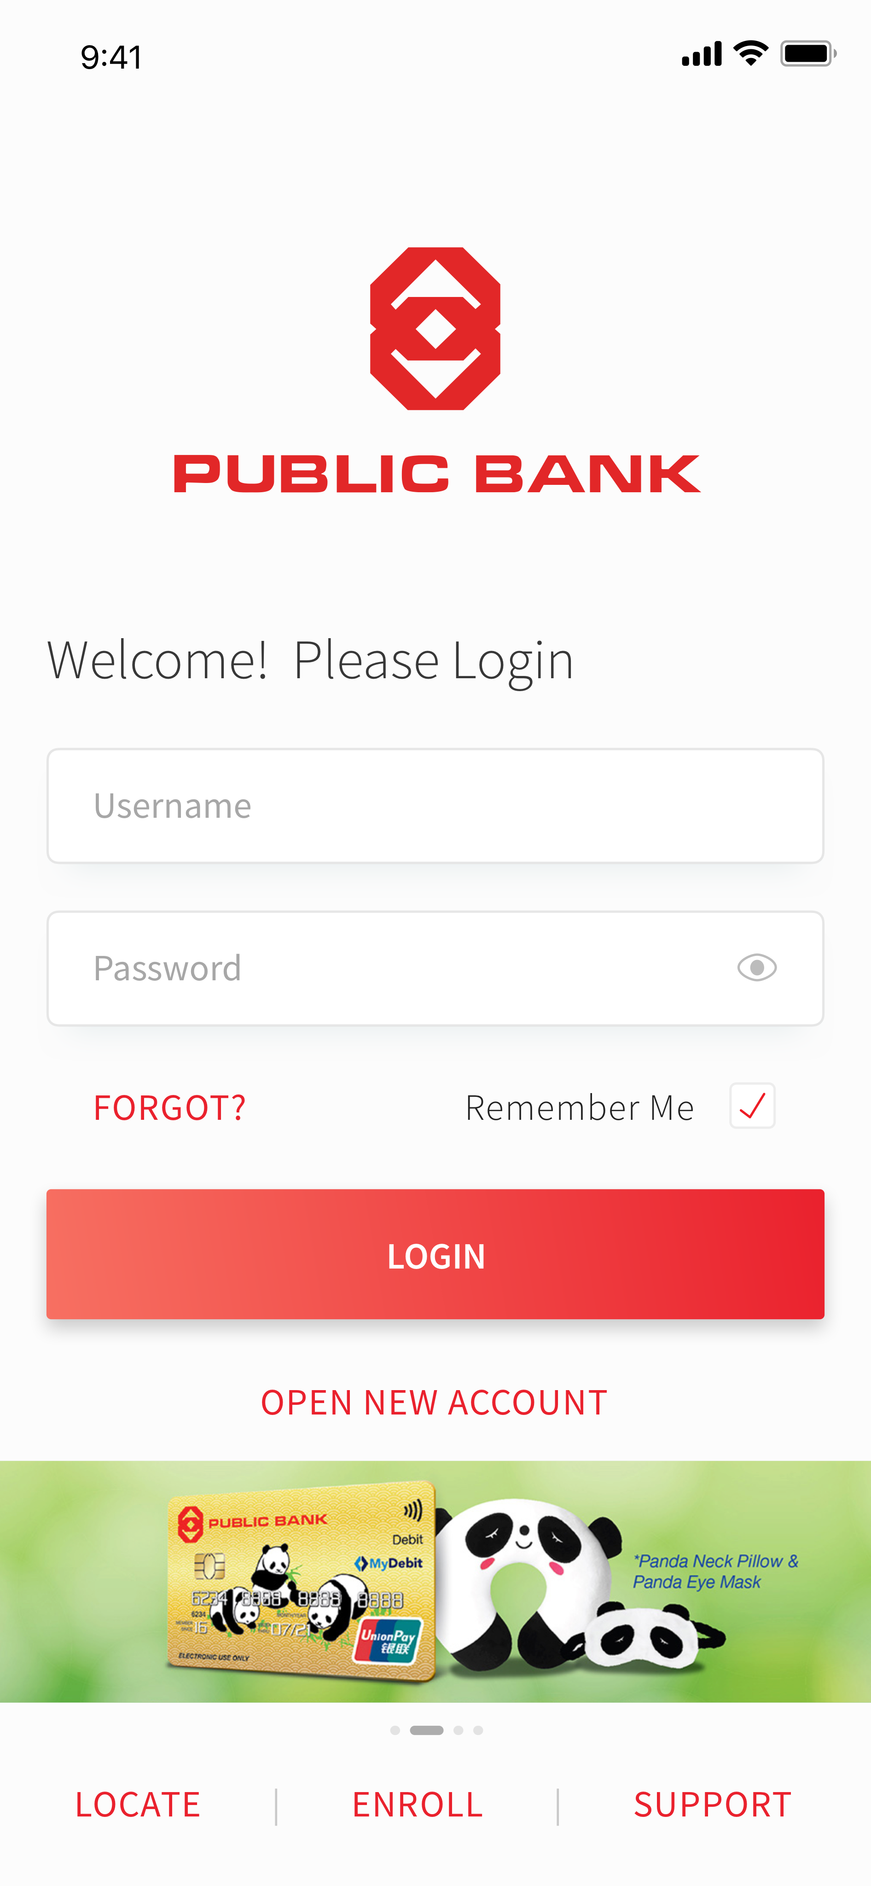
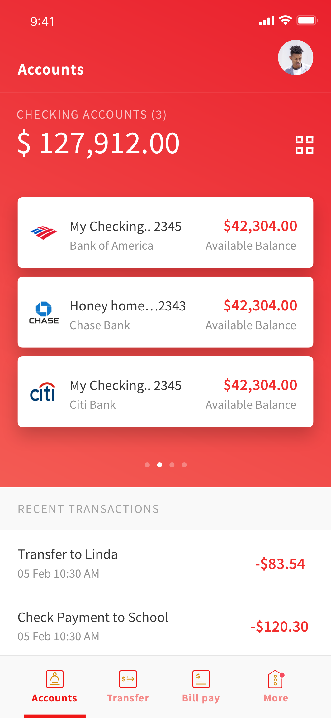
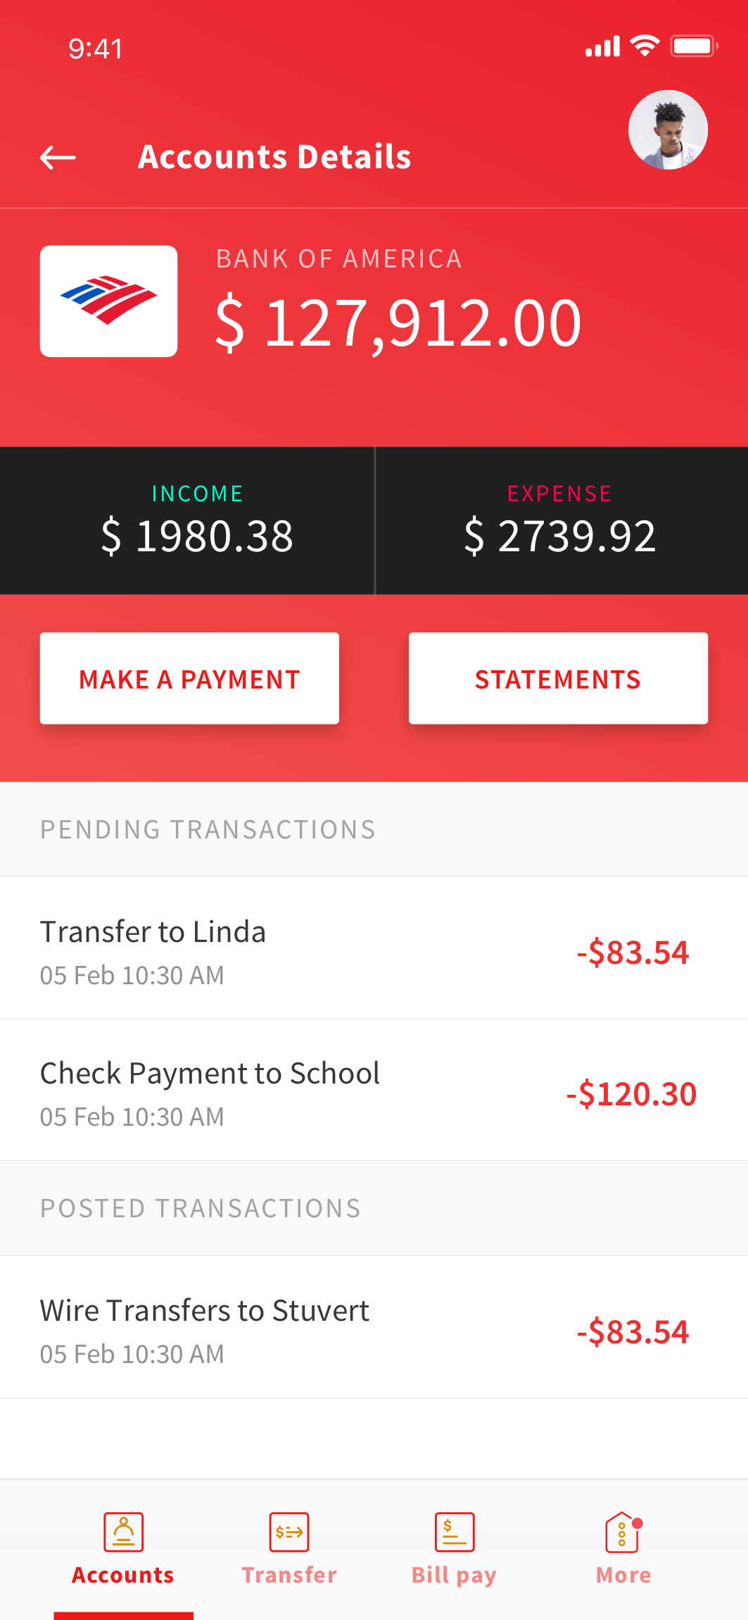
Public Bank
Category: Banking
Know your user

Slide 7
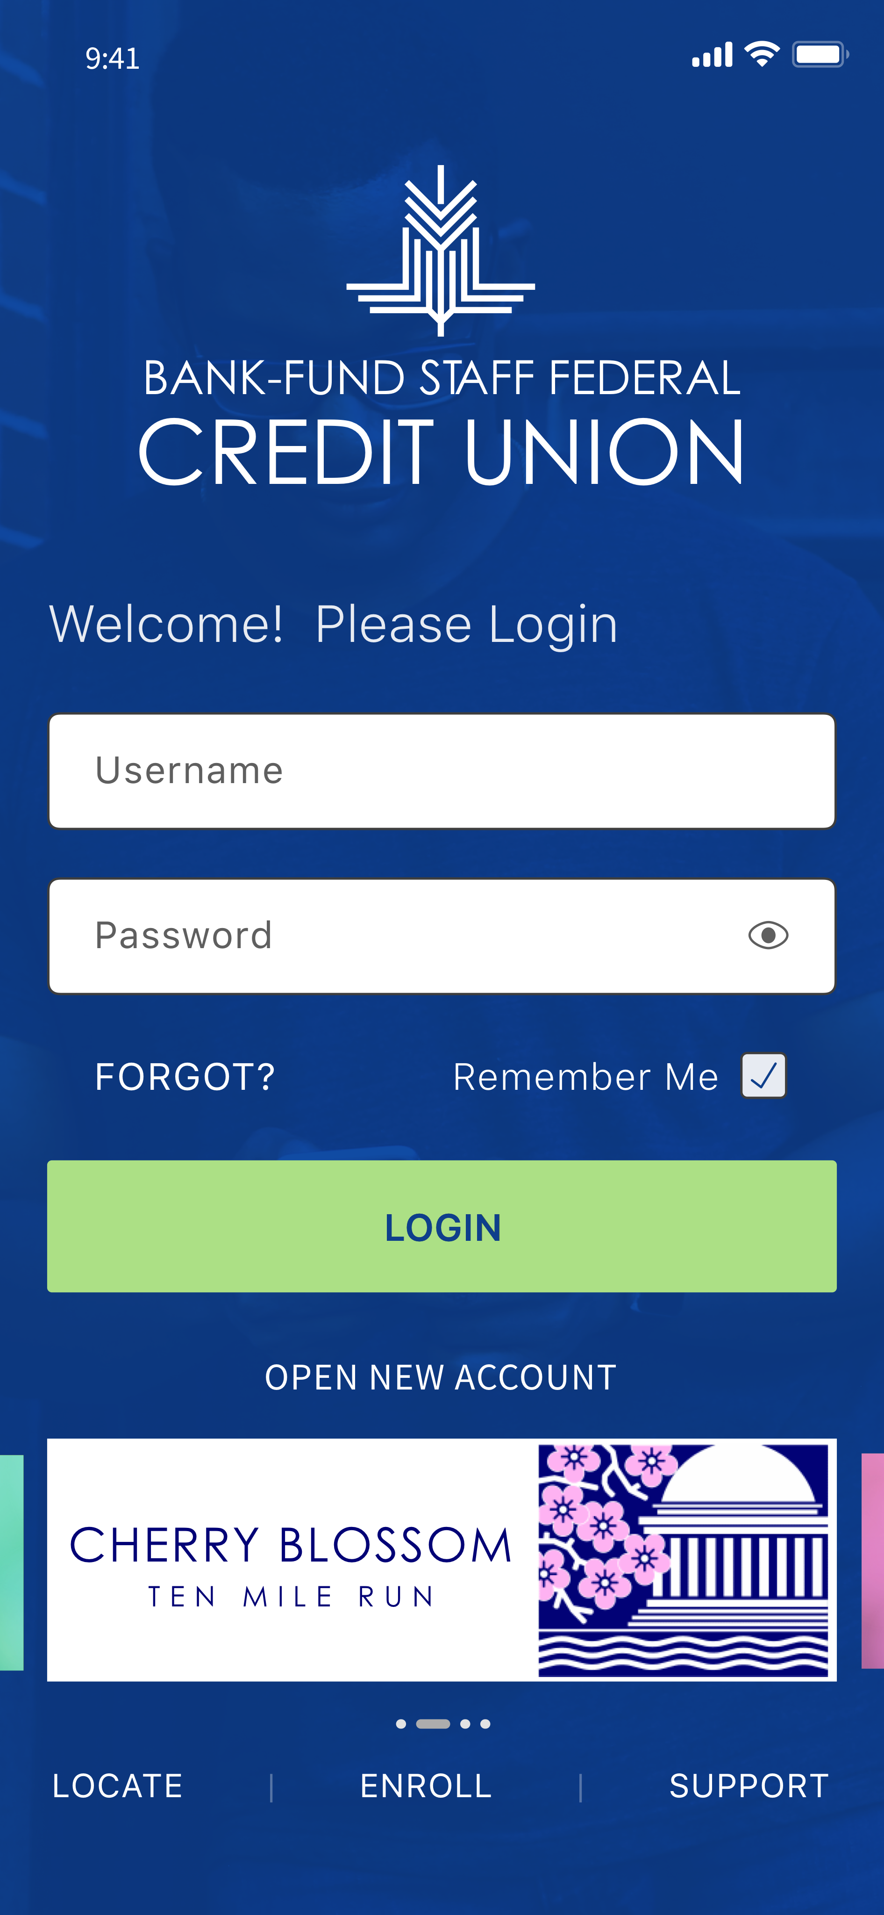
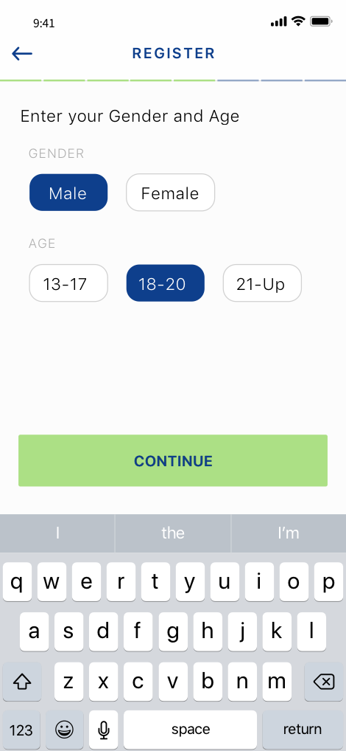
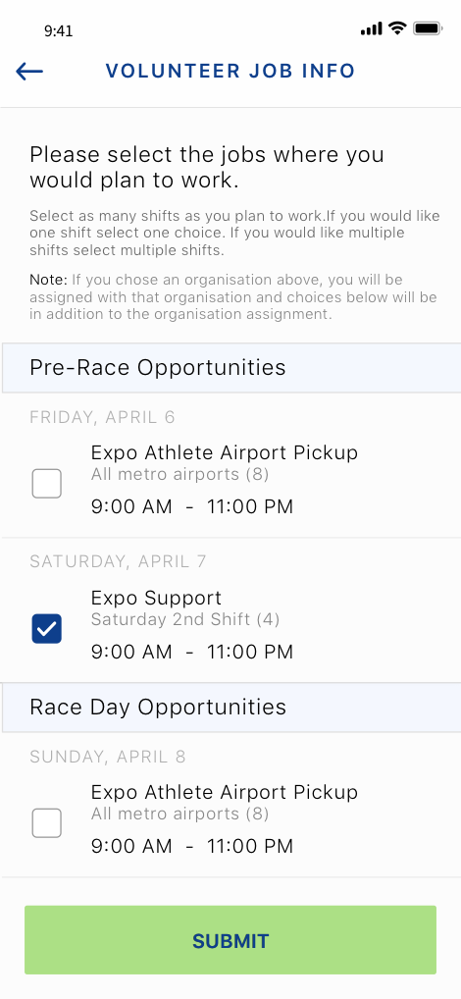
BFSFCU
Category: Banking
Know your user

Slide 8
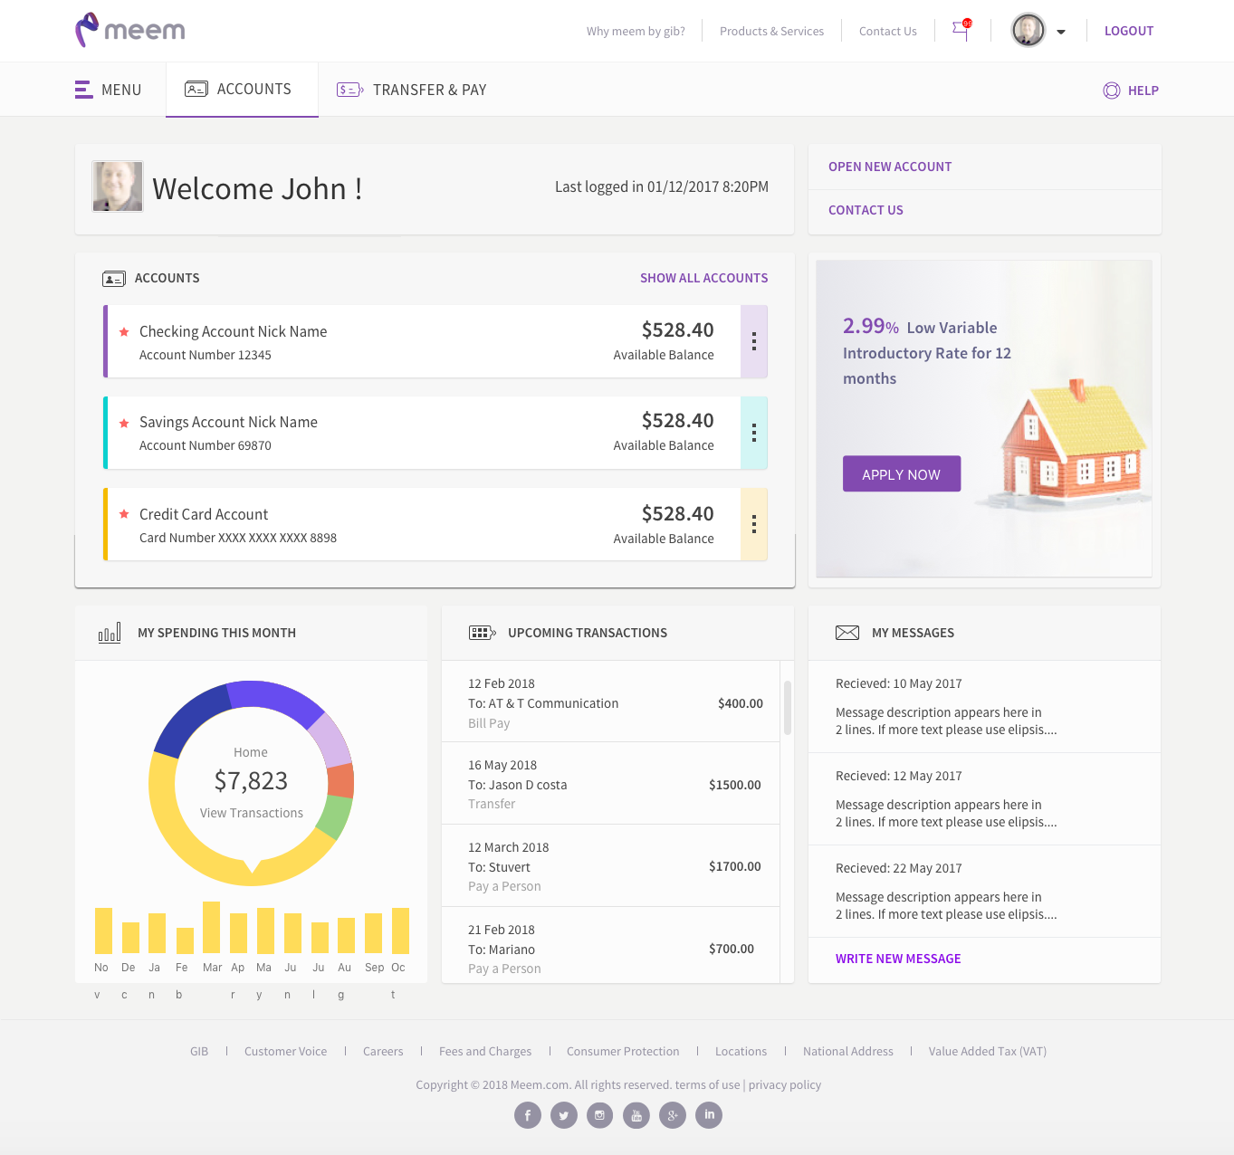
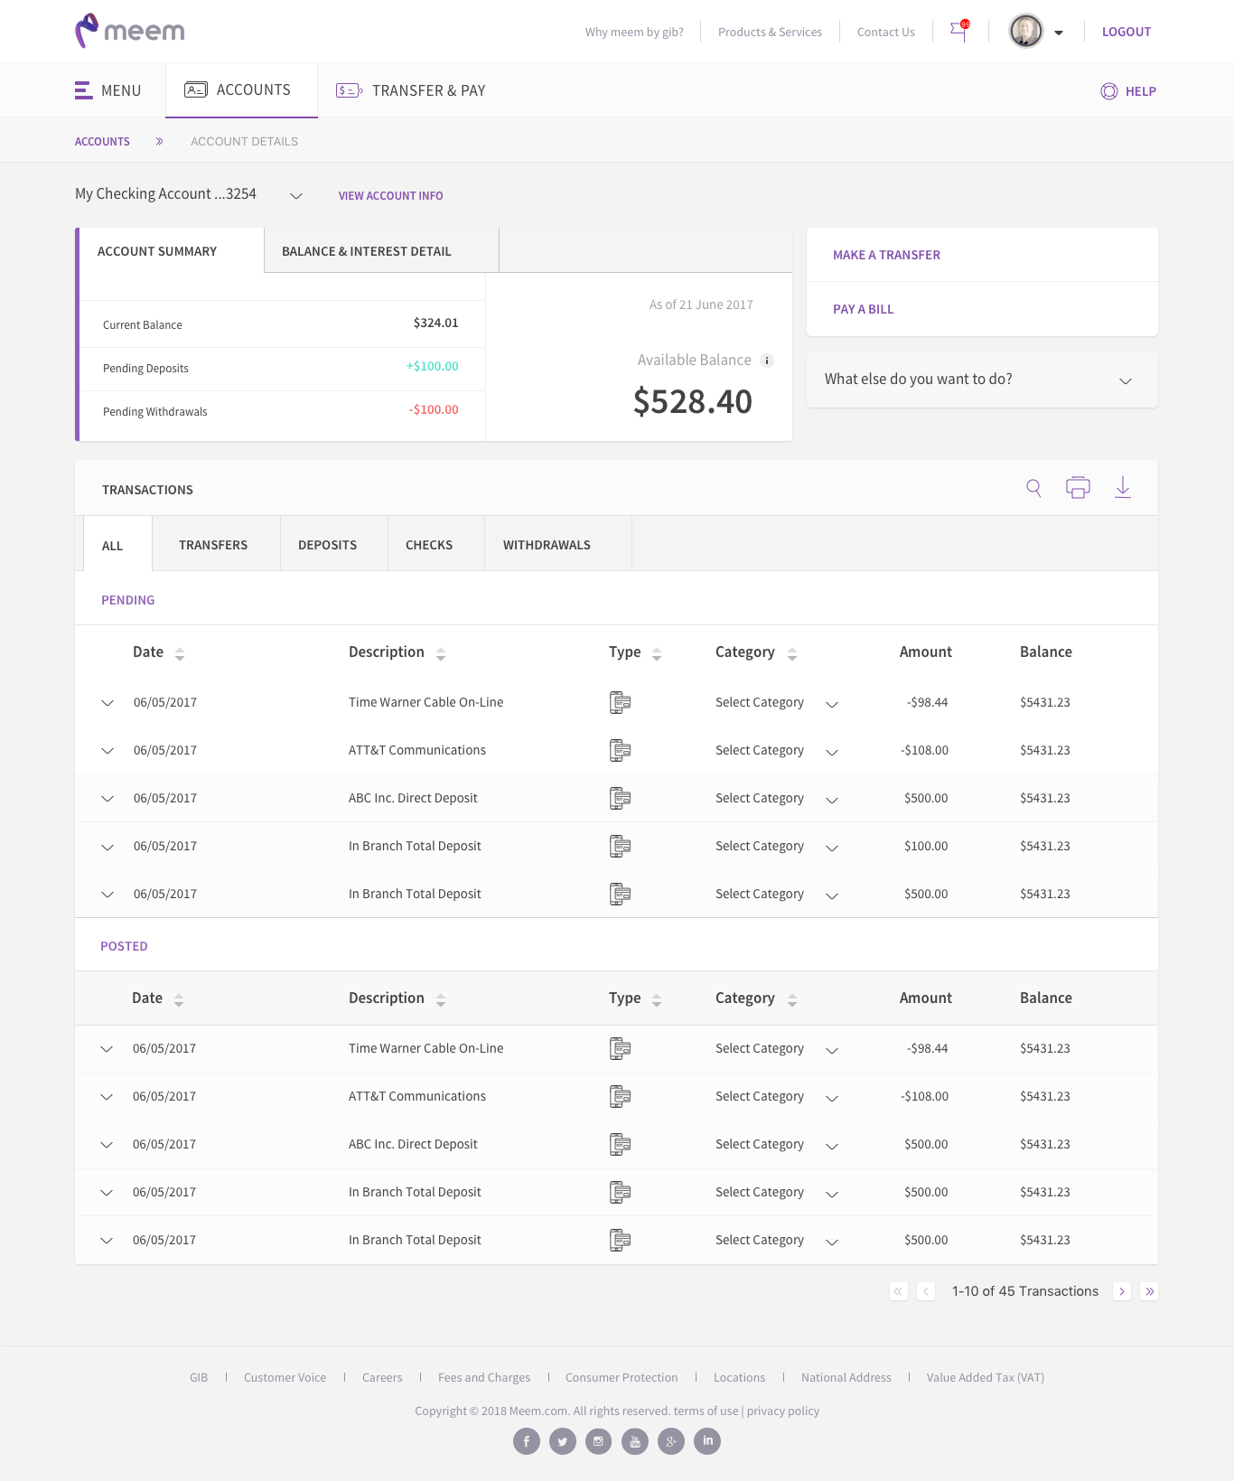
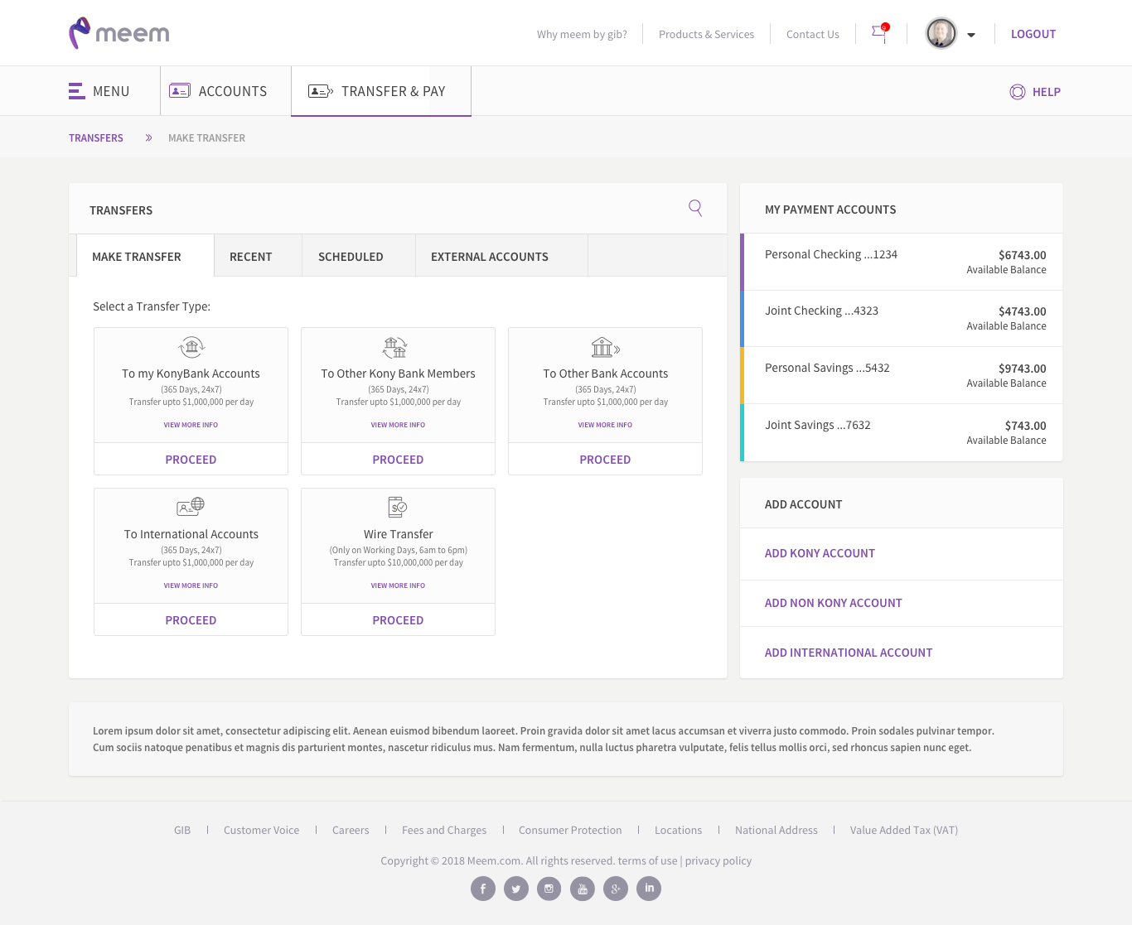
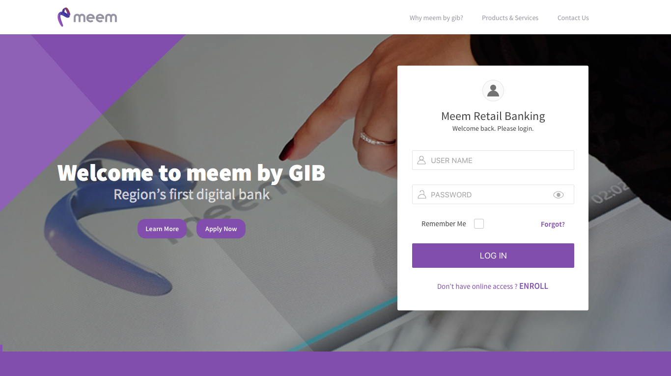
Meem
Category : Banking
Know your user

Slide 9
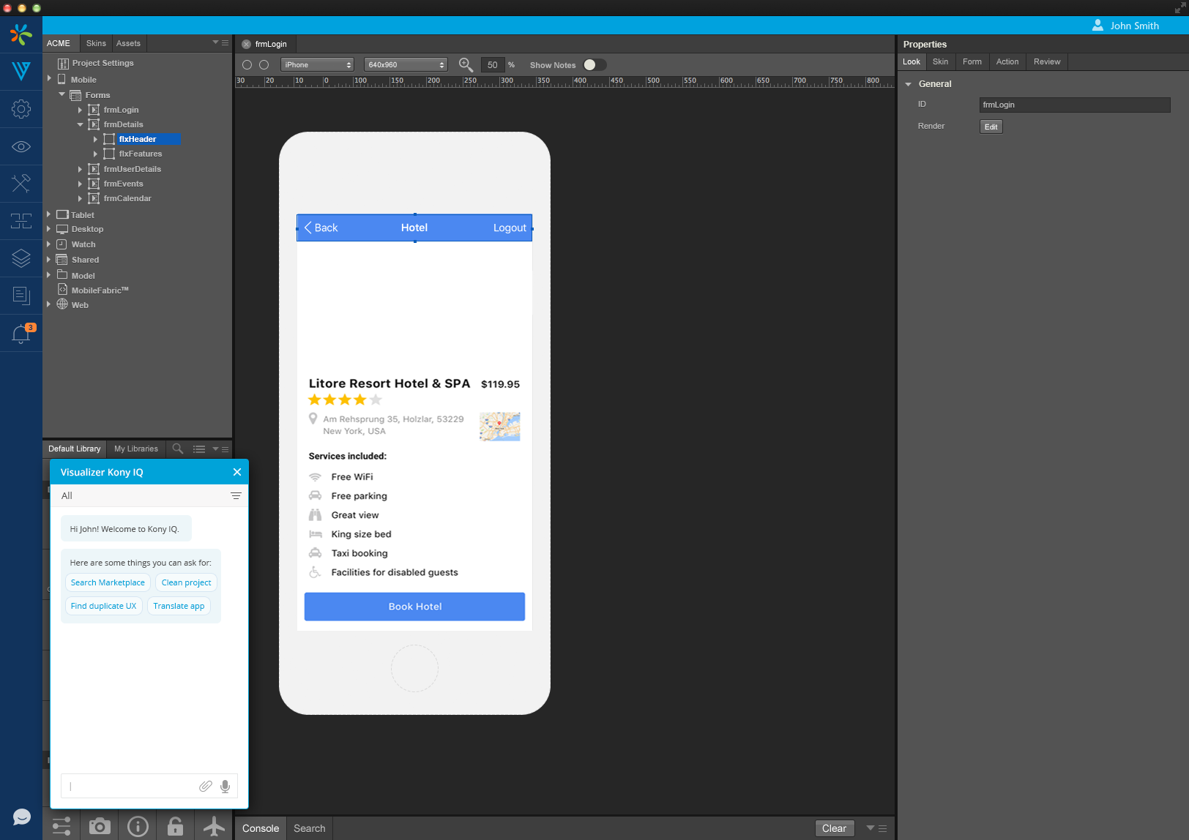
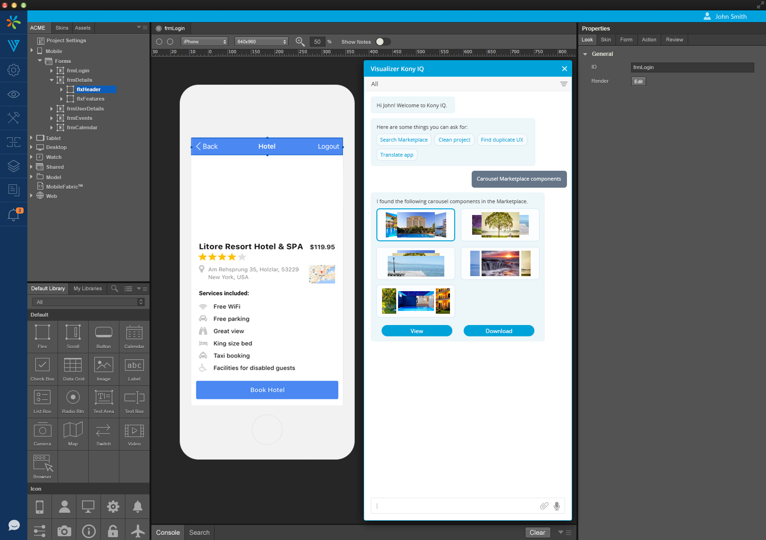
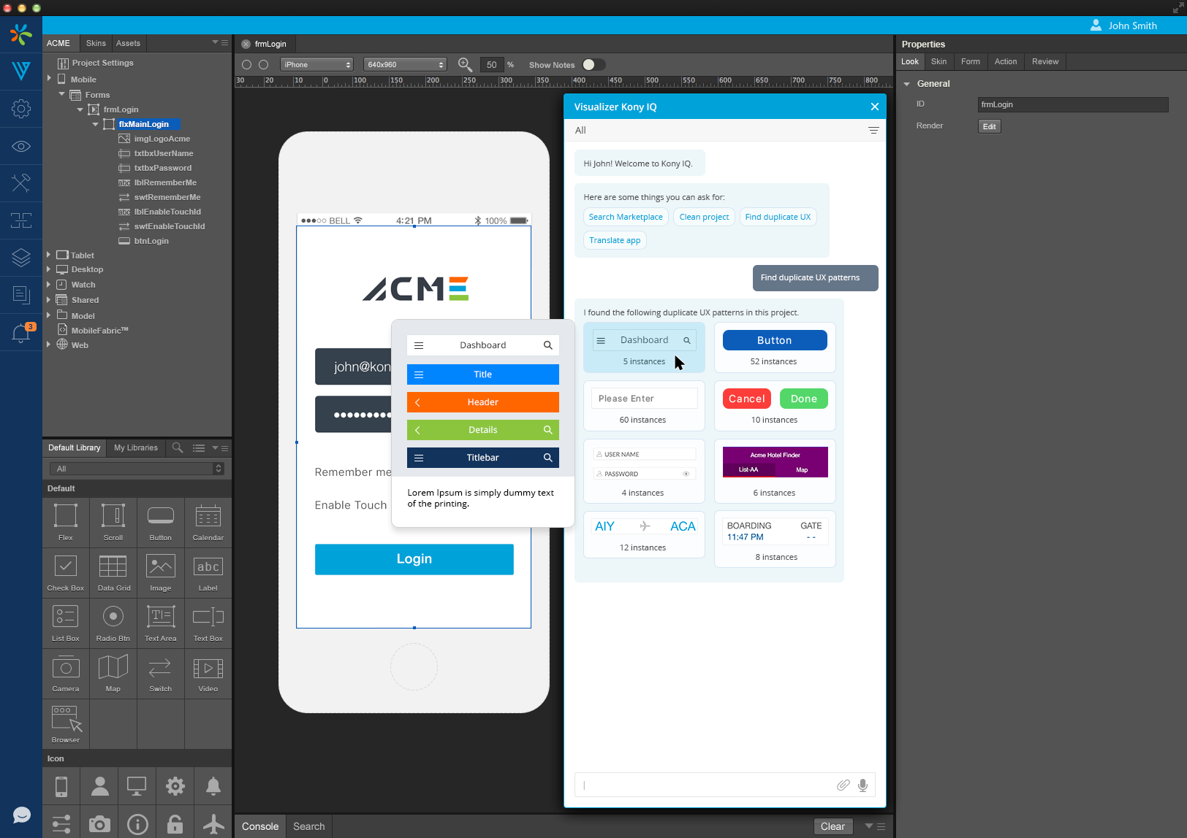
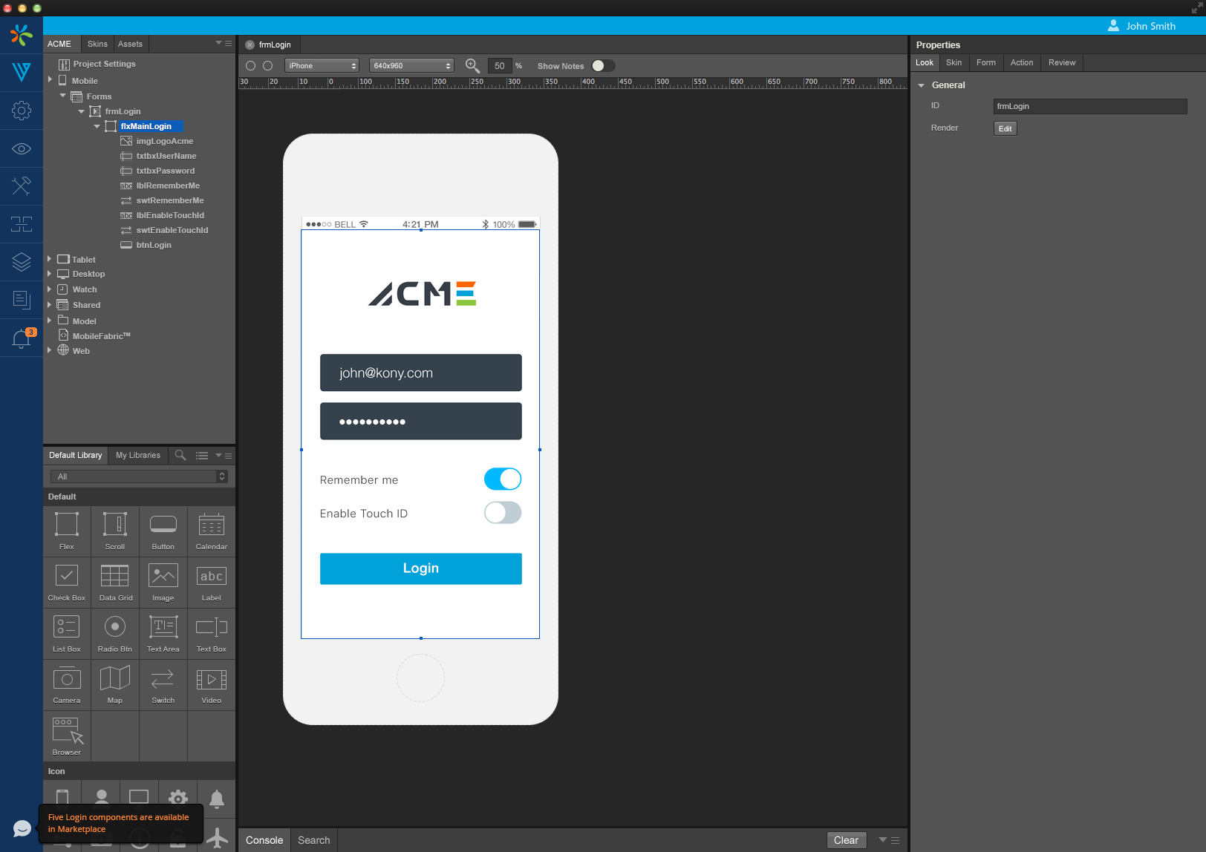
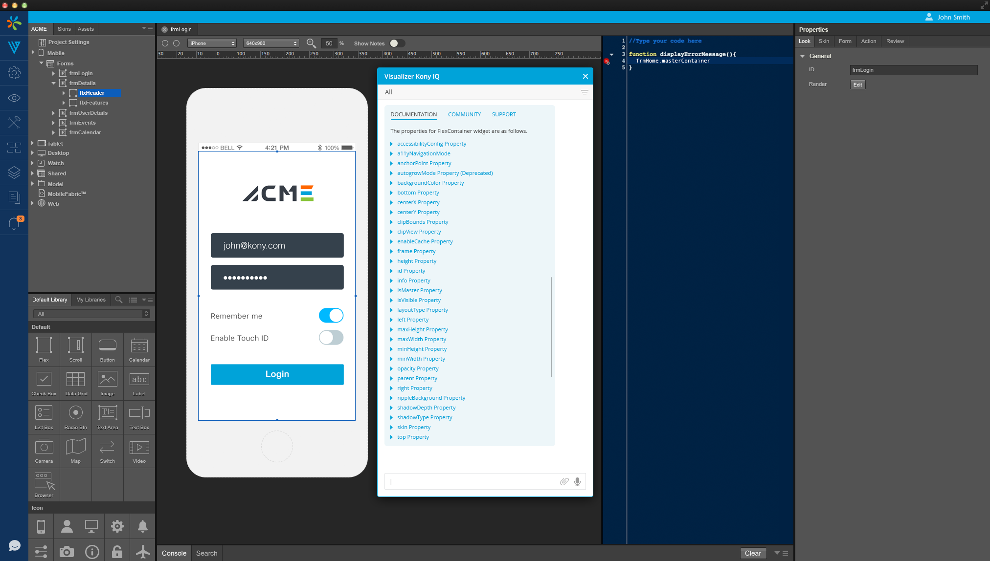
Kony IQ
Category: Incubation & Innovation
Use Cases
Component search
Duplicate UX pattern search
Help – Base Camp search
Code / Animation hints
Smart transitions / interactions
Know your user

Slide 10
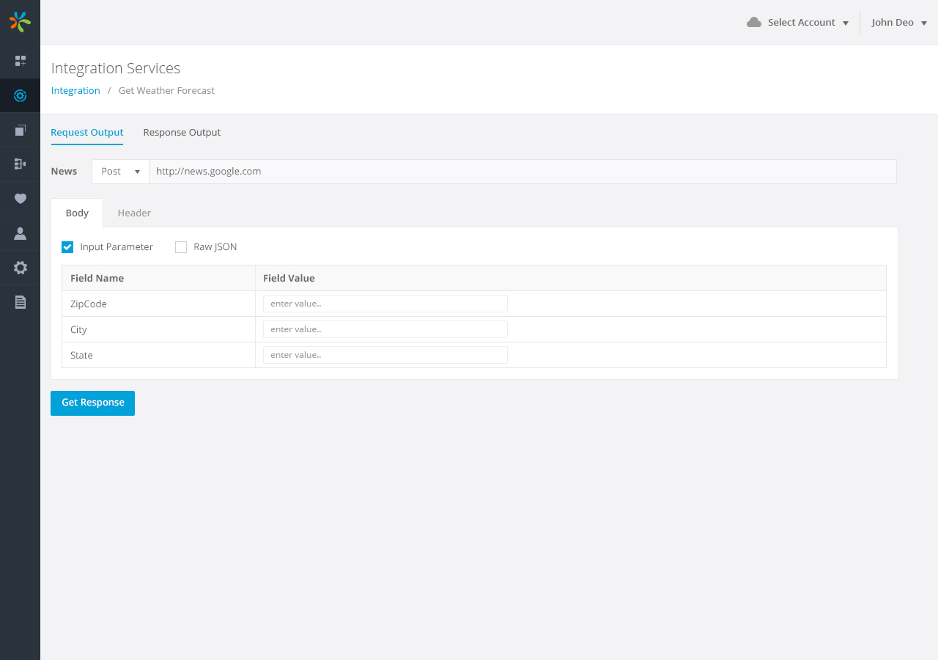
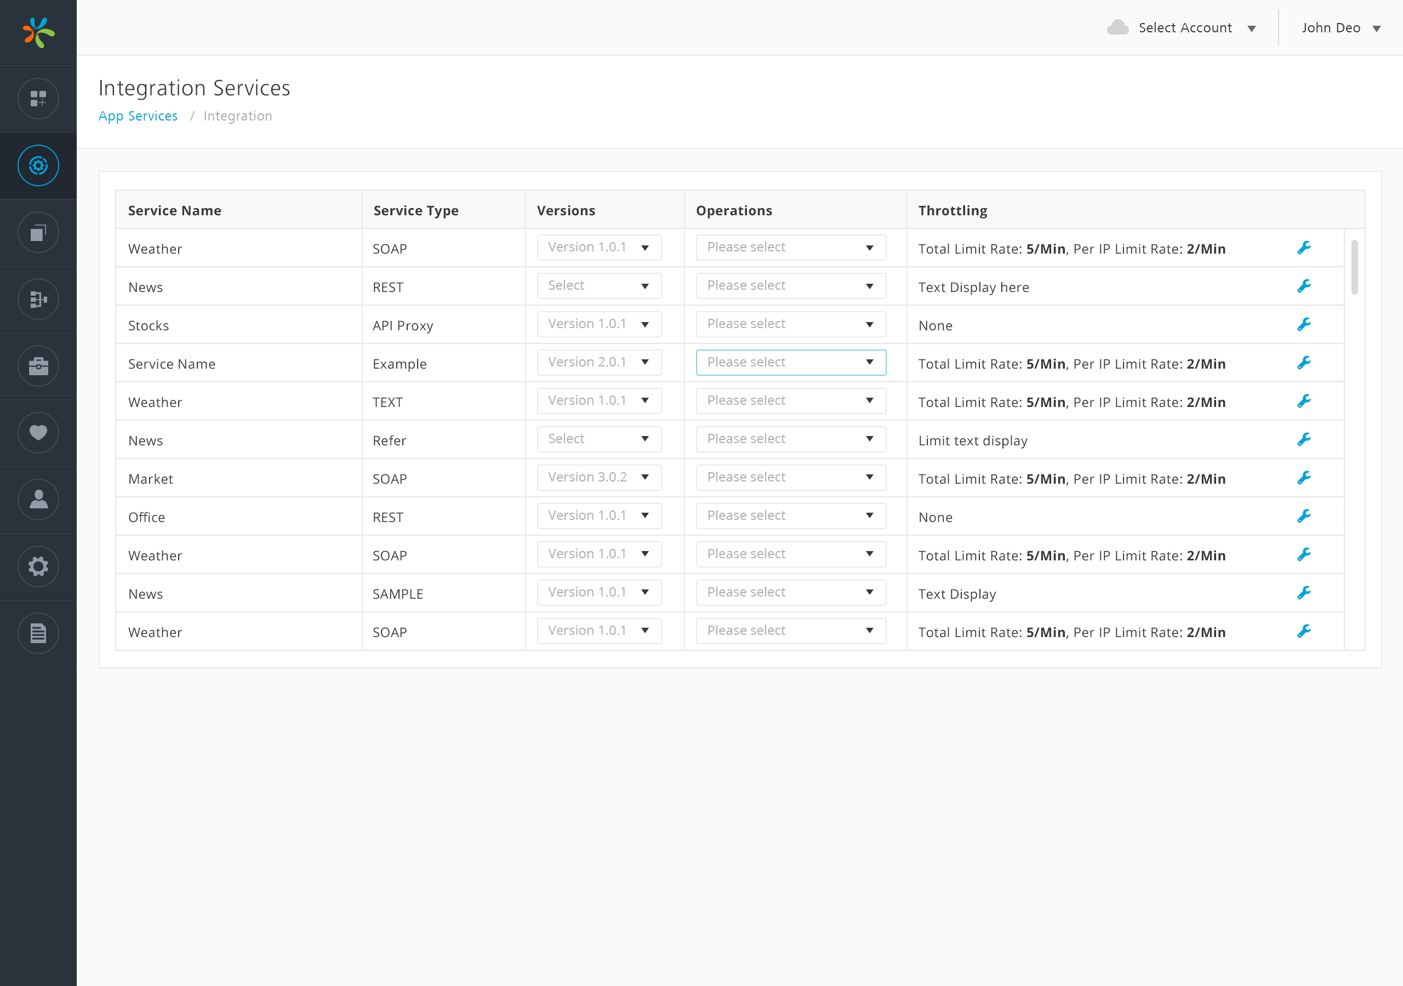
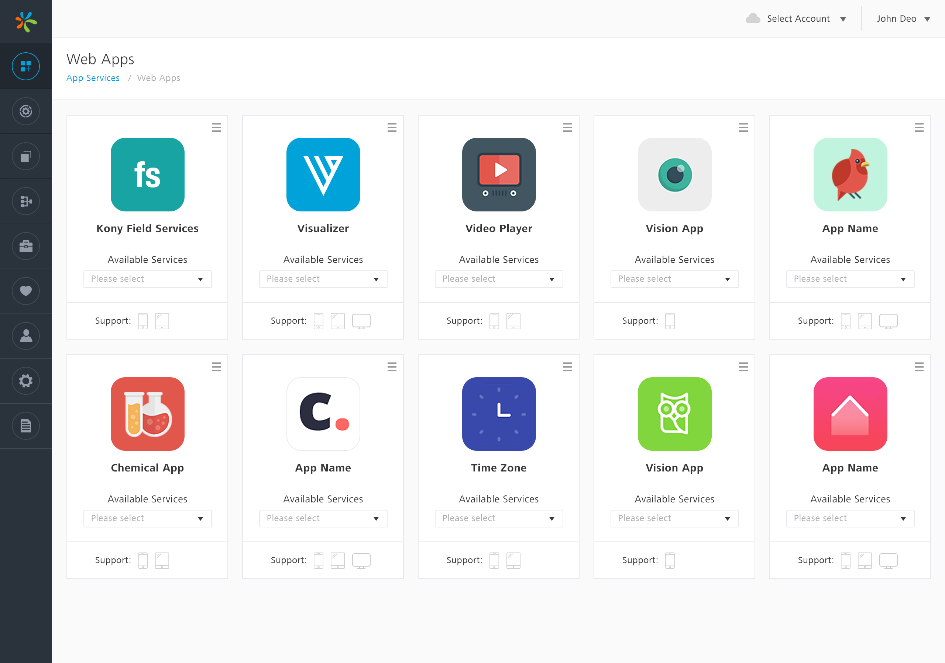
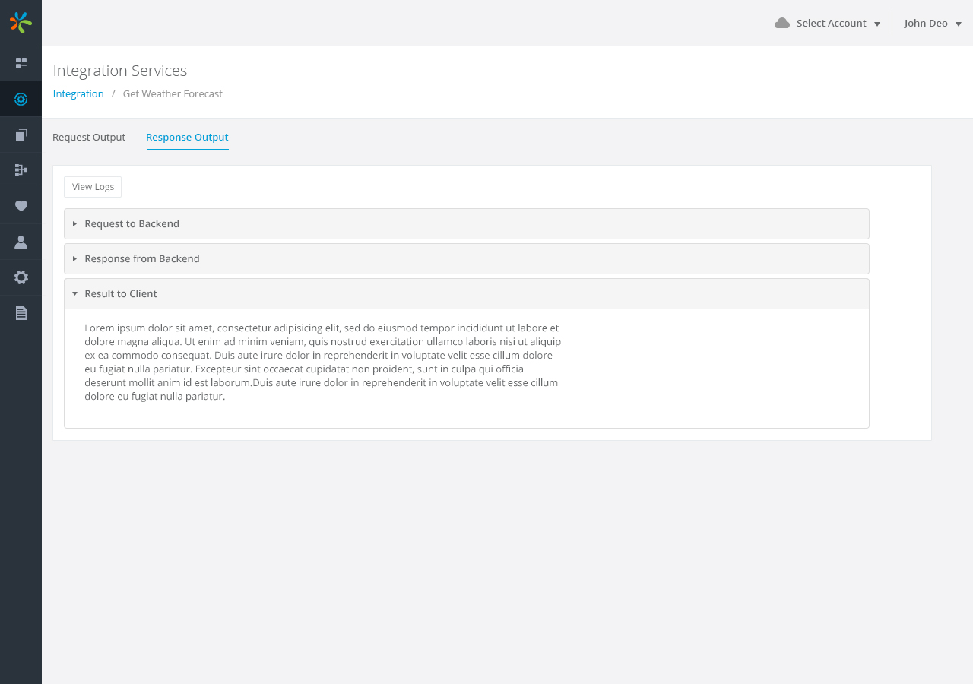
Admin Console
Category: Product
Research
An extensive research on latest trends and technologies, analyze market, competitors and user feedback.
Summary :
An extensive analyzing enabled us to create a next gen admin console using latest technologies and design patterns.
Know your user

Slide 11
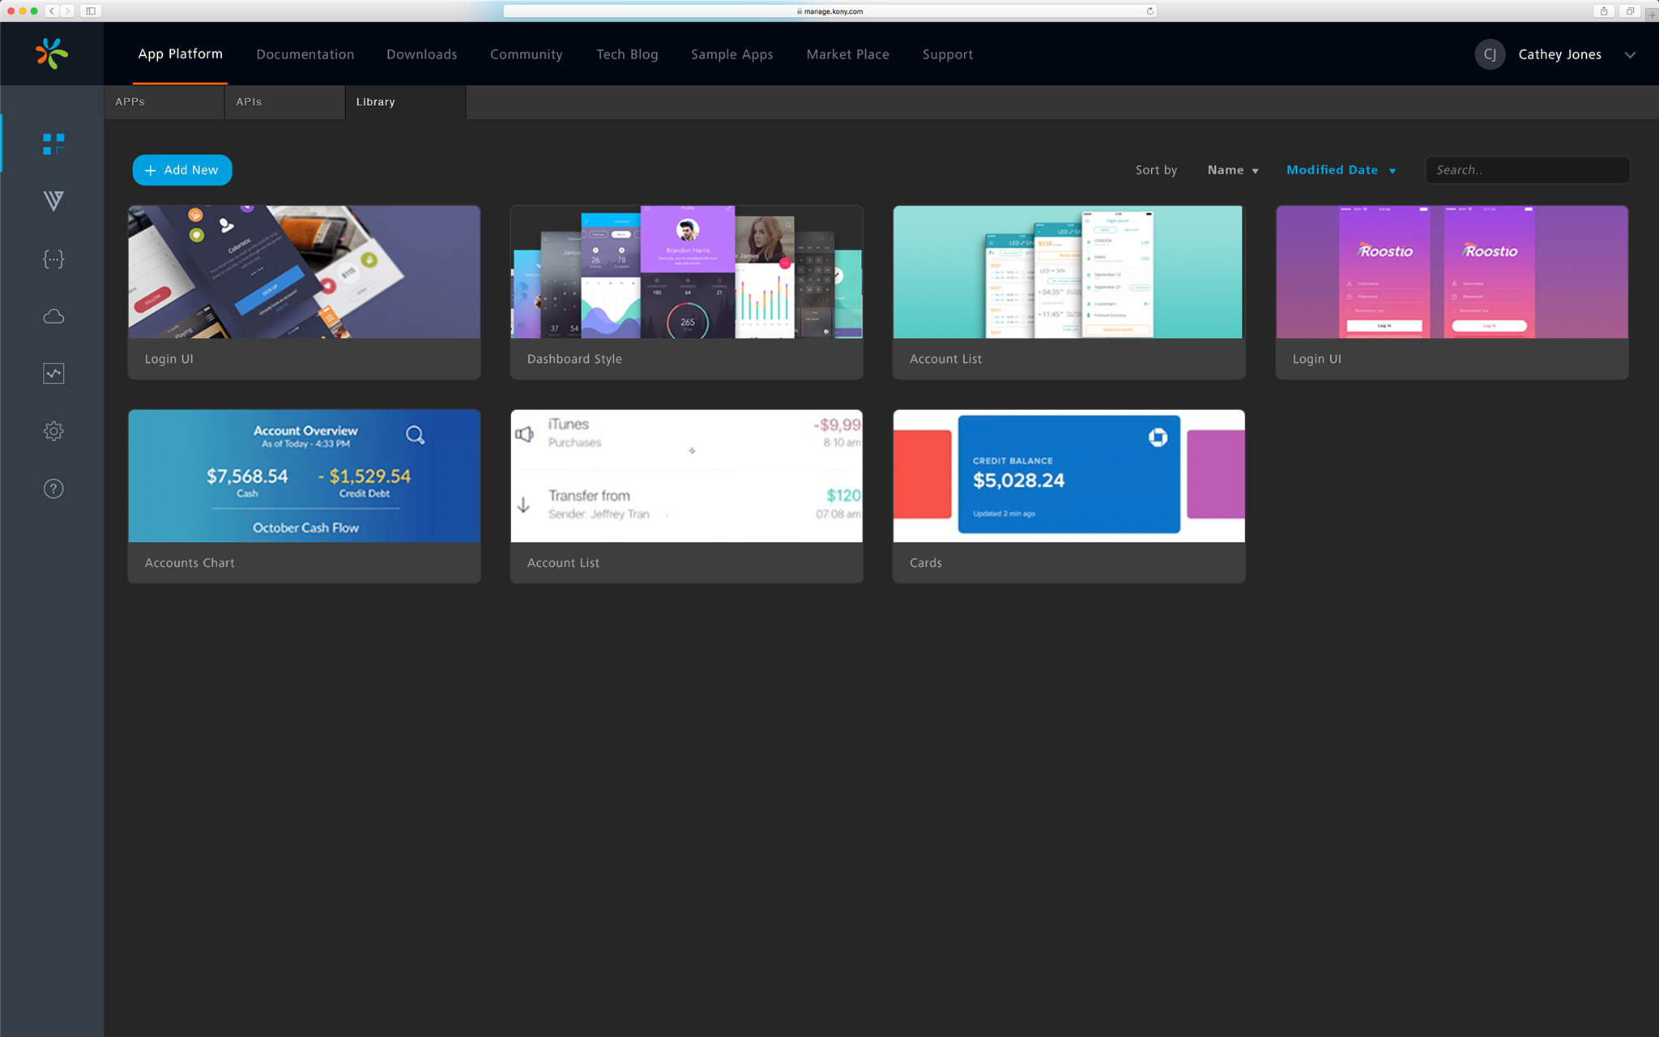
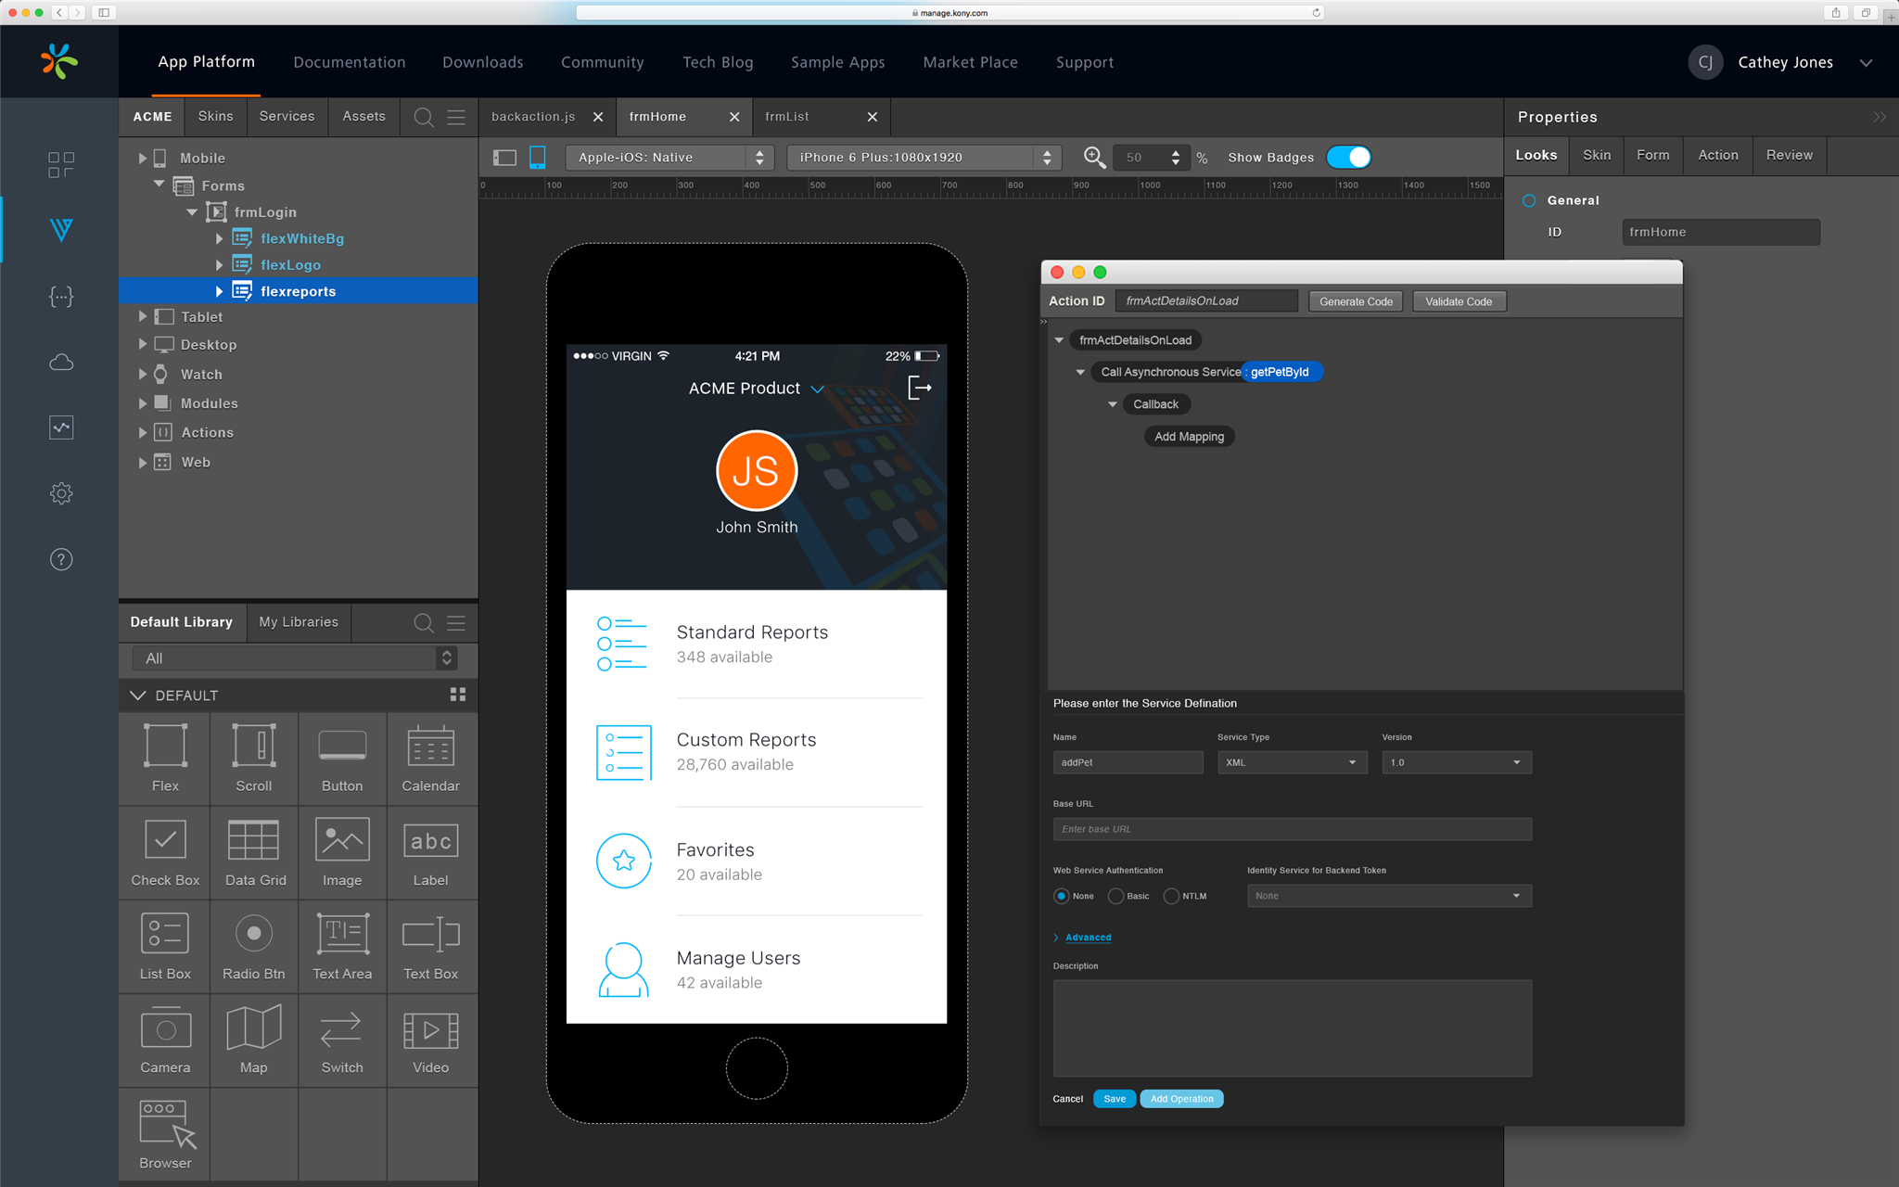
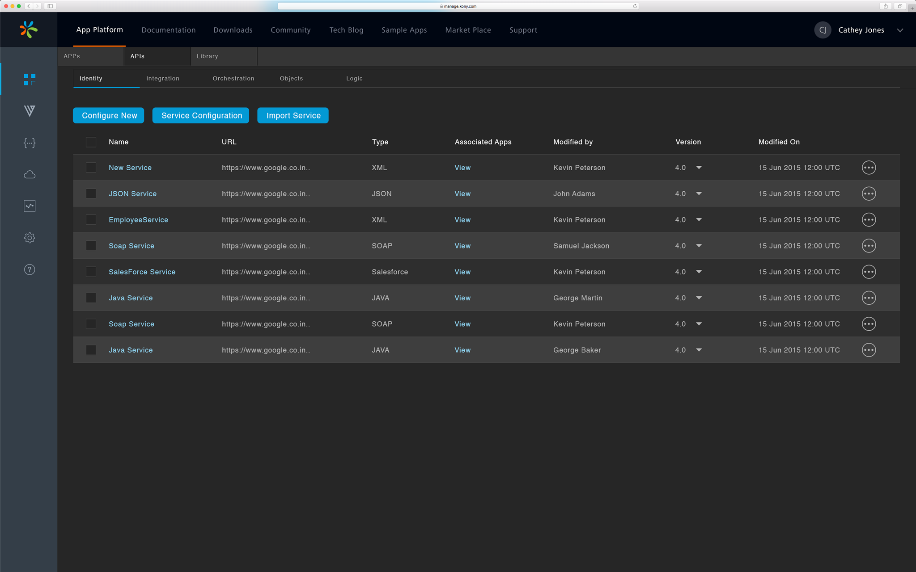
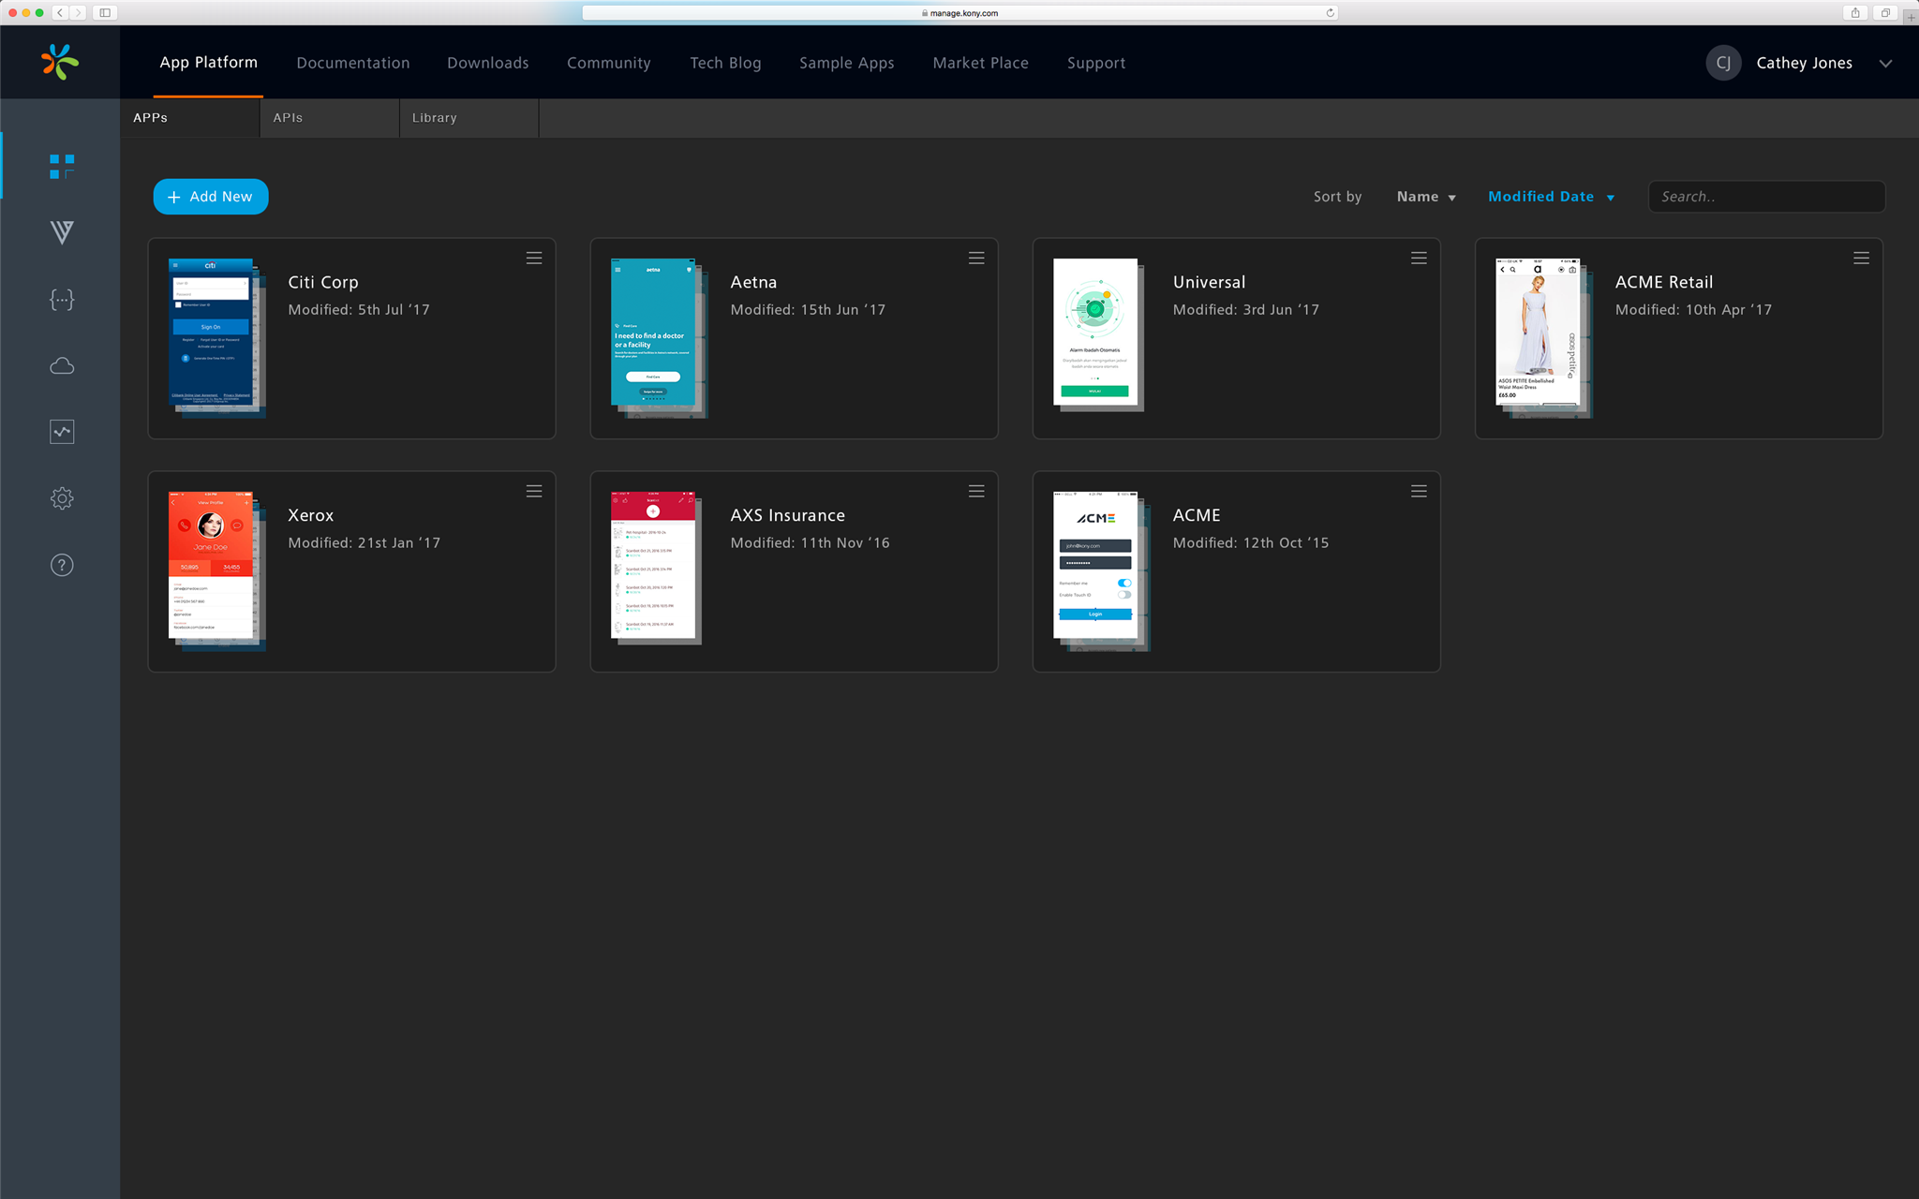
App Platform V 9.0
Know your user

Slide 12

Stakeholder’s feedback
East West Bank
Kinecta
“You made my day!”
“Meeting went well today. A little too well if there is ever such a thing.”
- Catherine (EWB)
“It was awesome. May have been the tipping point in the deal.”
- Vega, Carlos (Kinecta)
- Jeffery Kendall
“This one feels real. They loved the work Meetul and team did!”
“We demoed the Red Envelope yesterday and it was a huge hit with the EWB team.”
- Jeffery Kendall
- Nate Whaley
“This was the difference maker in the quarter and a great competitor win. Team – great job.”
- Tom
Know your user

Slide 13
Thank You
Name
Designation
Phone
Email ID
Richa Garg
UI Designer
+91 9465897336
richagarg278@gmail.com
Know your user

